Slide 1



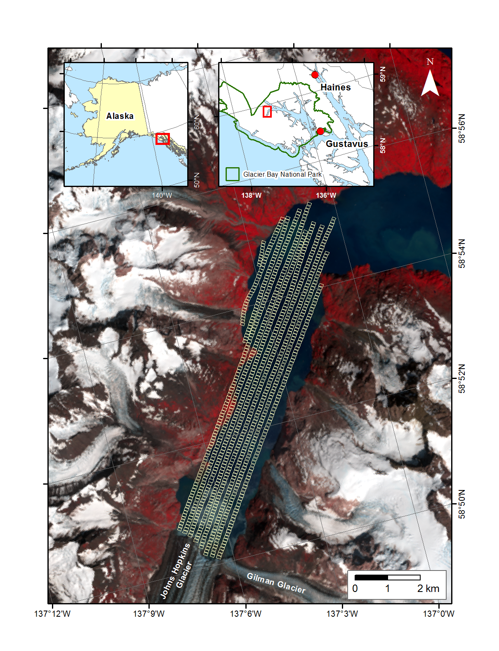
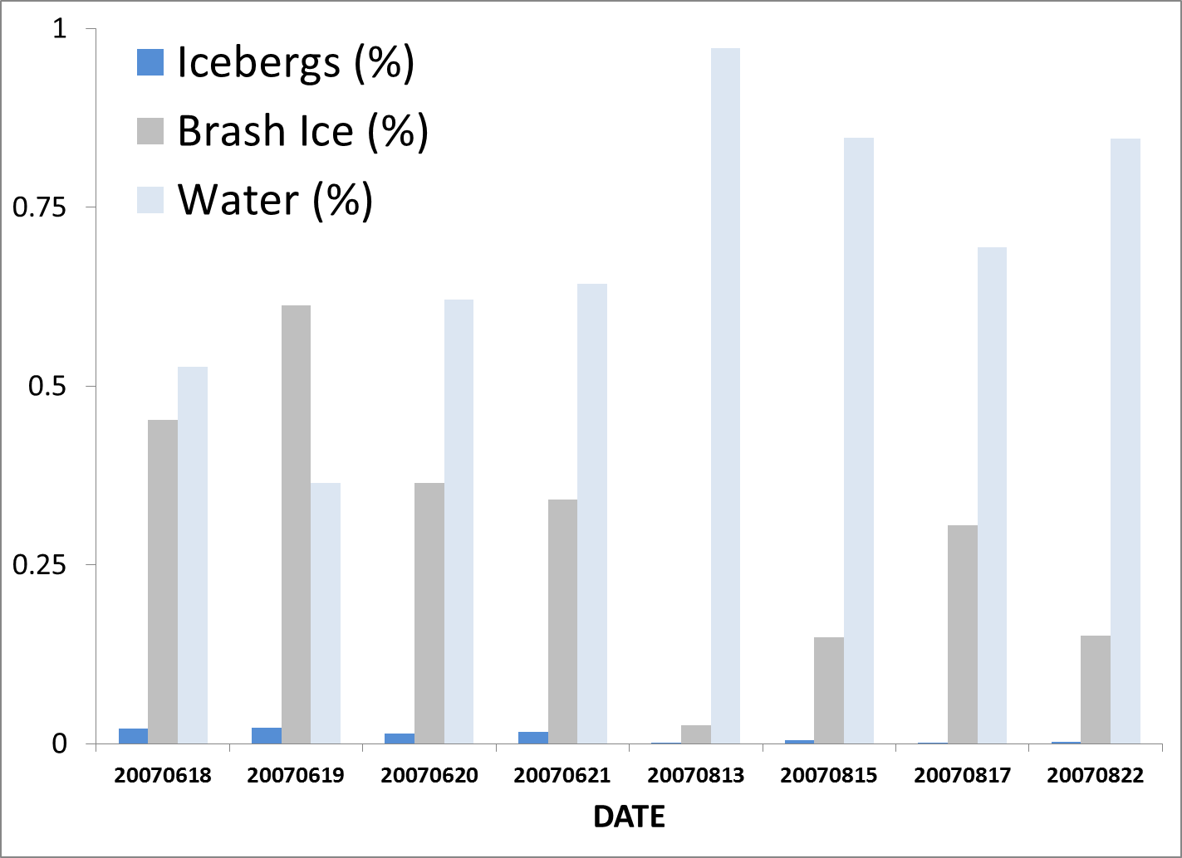
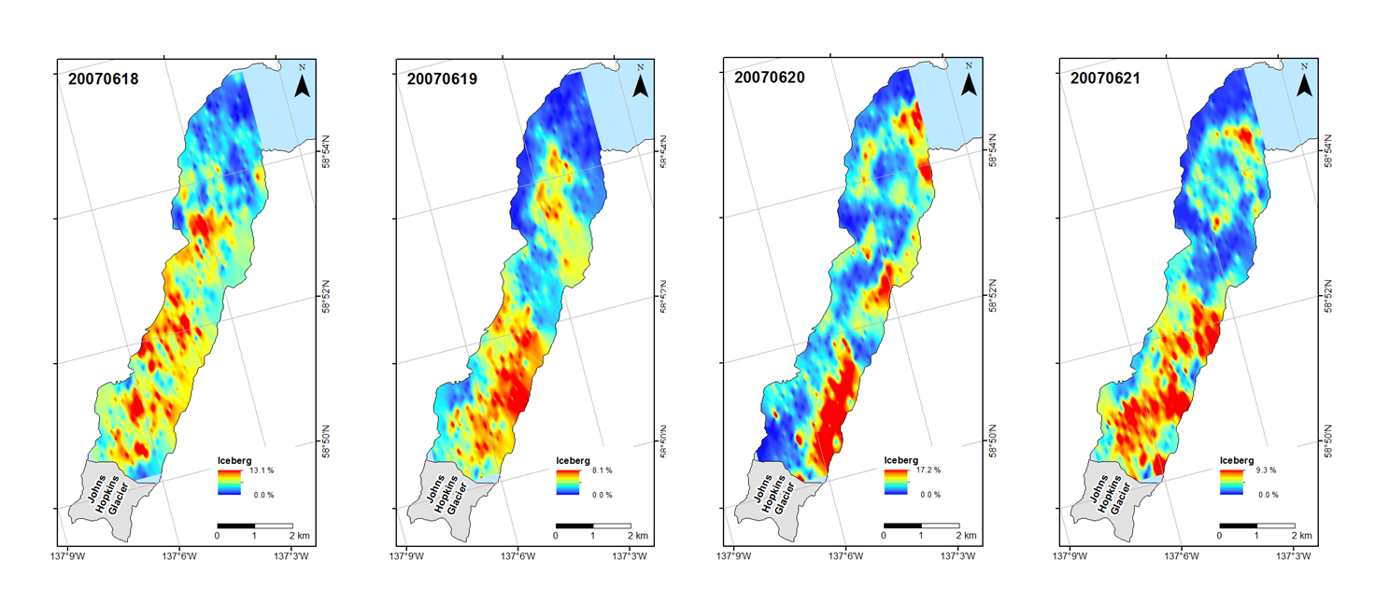
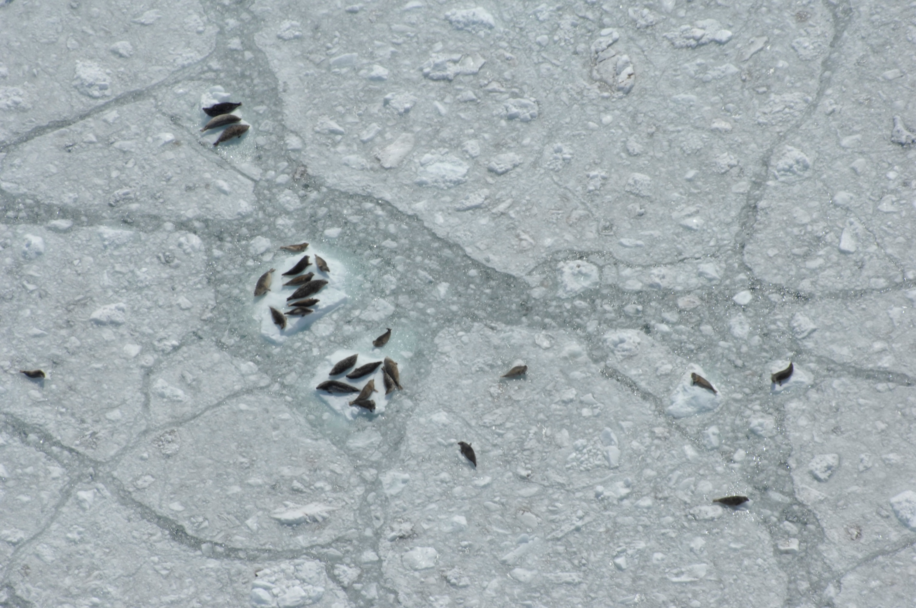
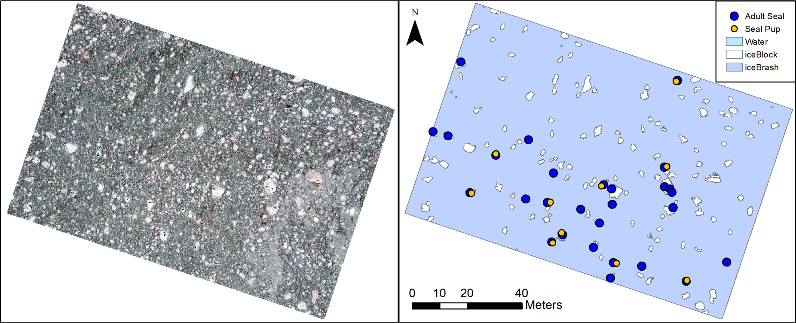
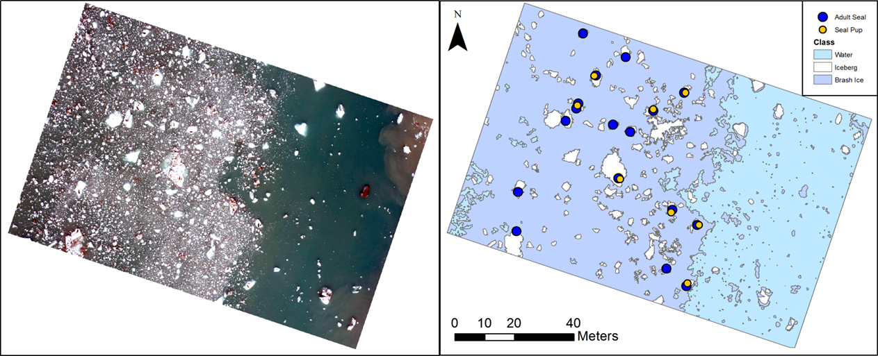
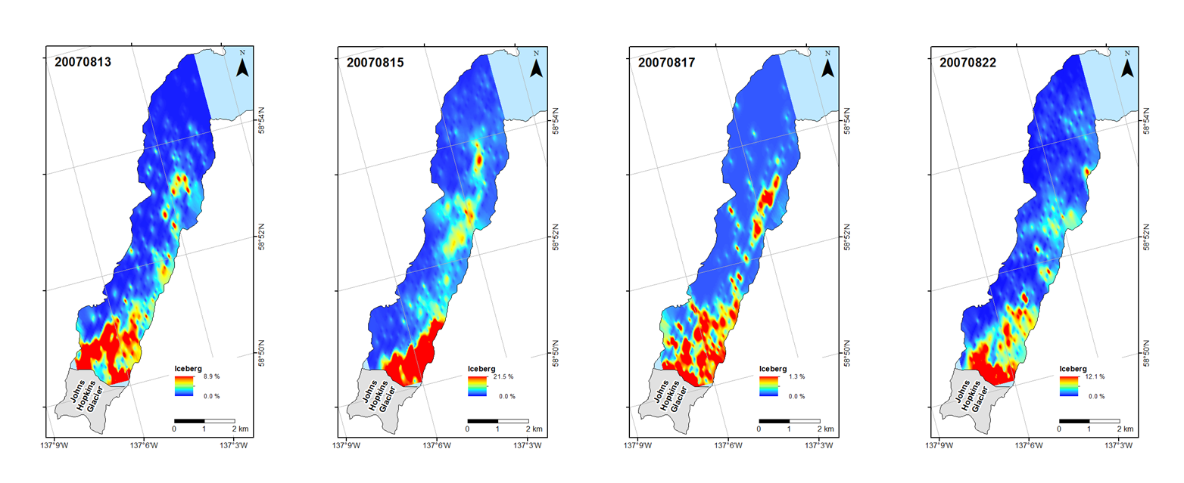

Spatio-temporal Variation in Glacier Ice as Habitat for Harbor Seals in a
Tidewater Glacier Fjord in Alaska
75830-C21A-0728
Jamie Womble¹, Robert W. McNabb², Rudiger Gens², Anupma Prakash²
National Park Service Glacier Bay Field Station, Juneau, AK ¹, Geophysical Institute University of Alaska Fairbanks, Fairbanks, AK²
Some of the largest seasonal aggregations of harbor seals in the world occur in tidewater glacier fjords in Alaska (Jansen et al. 2014).
Harbor seals exhibit a high degree of fidelity to tidewater glacial fjords during the pupping and molting seasons (Womble & Gende 2013).
Glacier ice serves as an important substrate for harbor seals for resting, pupping, and nursing young in glacier fjords.
The distribution, amount, and size of floating ice are likely key environmental variables that influence the spatial distribution and abundance of harbor seals in tidewater glacier fjords.
However, the fine-scale characteristics of glacier ice used by seals have never been quantified from high spatial resolution airborne imagery.
We are assessing the seasonal changes in ice habitat for harbor seals in Johns Hopkins Inlet, Glacier Bay National Park in southeastern Alaska.
We are quantifying the fine-scale characteristics of ice available for seals using object-based image analysis.
We will be linking seal distribution to ice characteristics using spatial models.
Aerial photographic surveys (n = 8) were conducted of seals and ice In Johns Hopkins Inlet during the pupping (June) and molting (August) seasons during 2007.
Surveys were flown along a grid of 12 transects and high-resolution digital photos were taken directly under the plane using a vertically aimed camera.
The spatial distribution of harbor seals was mapped in GIS.
Object-based image analysis was to quantify the fine-scale characteristics of glacier ice including:
-% icebergs per scene (ice ≥ 1.6m²)
-% brash ice per scene (ice ≤ 1.6m²)
-% open water per scene
-iceberg size (m²)
-iceberg angularity (an index of iceberg shape)
The spatial distribution of floating glacier ice was more extensive in June than in August 2007.
Average % icebergs (June: 1.8% ± 1.6; August: 0.2%± 0.7) and
% brash ice (June: 43.8% ± 38.9; August: 15.8% ± 26.4) were greater in June than in August.
Average % open water was greater in August (84.1% ± 9.9) than in June (53.9% ± 10.9).
Average iceberg size was greater in June (5.6 m² ± 0.1) than in August (3.3 m² ± 1.3).
Seal abundance was consistently higher during June (range: 1,672-4,340) than during August (range: 1,075-2,582).
Several factors may influence the spatio-temporal variation in ice habitat for seals including frontal ablation rates, fjord circulation, submarine melting, and local winds.
Background & Overview
Methods
Results
The availability of icebergs,
brash ice, and open water
changes seasonally in
Johns Hopkins Inlet and likely
influences the spatial distribution and abundance of harbor seals.
Study area in Johns Hopkins Inlet.
Digital image of seals on iceberg and ice classification.
Distribution of icebergs in Johns Hopkins Inlet in June (upper panel) and August (lower panel).
Harbor seals resting on glacier ice in Johns Hopkins Inlet in Glacier Bay National Park, Alaska.
Digital images of seals and ice.
Ice classification and mapped seals from digital images.
Acknowledgements: We thank John Jansen for sharing his expertise and assistance in establishing aerial survey methods. Melissa Senac (NPS) and
Evelina Augusston (Karlstad University), and Lou Taylor-Thomas assisted with mapping seal distribution. Avery Gast (Ward Air) provided safe and efficient
air support. Funding was provided by the National Park Service, Glacier Bay National Park, National Marine Mammal Laboratory, and the Geophysical
Institute University of Alaska Fairbanks.

